Slide 1
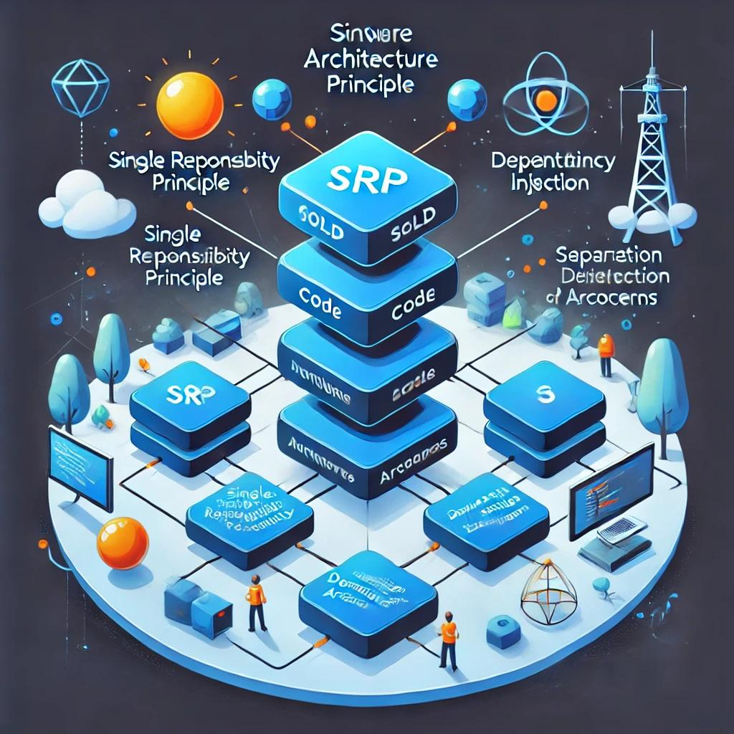
Applying SOLID & SRP in Laravel
An overview of structuring code for maintainability and testability.

Slide 2
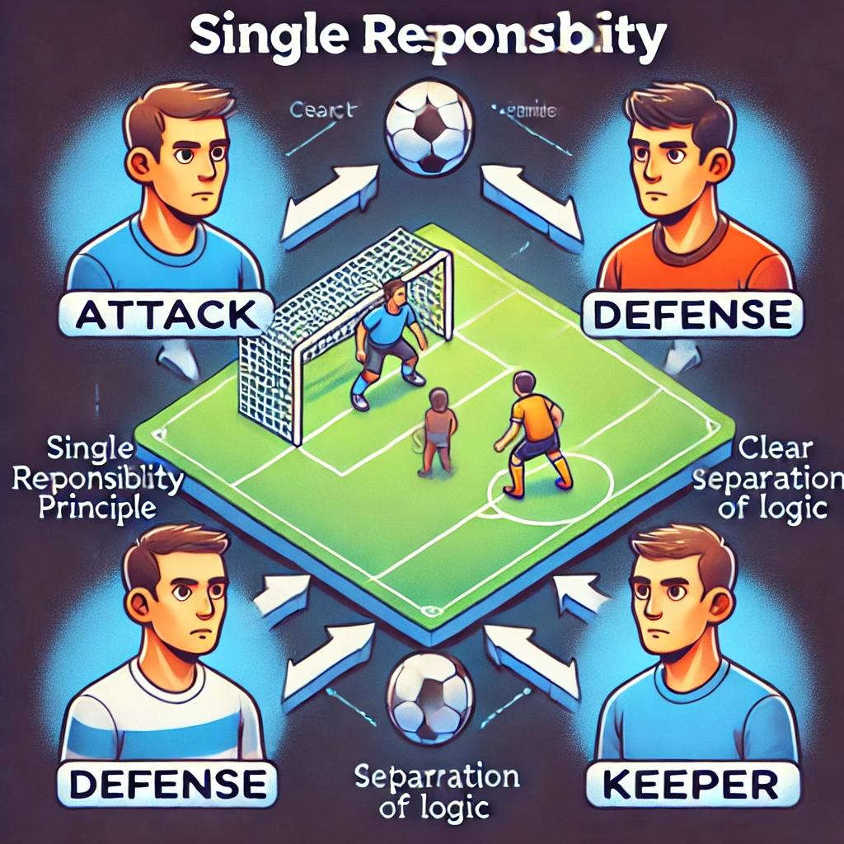
What is SRP?
single responsibility principle
Definition: A class should have only one reason to change.
Goal: Enhance maintainability, testability, and clarity.
Context: We applied SRP to a simple 'Match Simulation' program that involves:
- Attack
- Defense
- Keeper (Goalkeeping)

Slide 3
Example That Breaks SRP
Single Class Approach:
- All logic (attack, defense, keeper) bundled into one class.
- File: app/Models/Match.php
Issues:
- Multiple reasons to change
- Harder to maintain and test
Code Snippet:
class Match {
public function simulate() {
$attackResult = $this->attack();
$defenseResult = $this->defense();
$keeperResult = $this->keeper();
return compact('attackResult', 'defenseResult', 'keeperResult');
}
protected function attack() { return 'Attack executed!'; }
protected function defense() { return 'Defense executed!'; }
protected function keeper() { return 'Keeper saved the ball!'; }
}

Slide 4
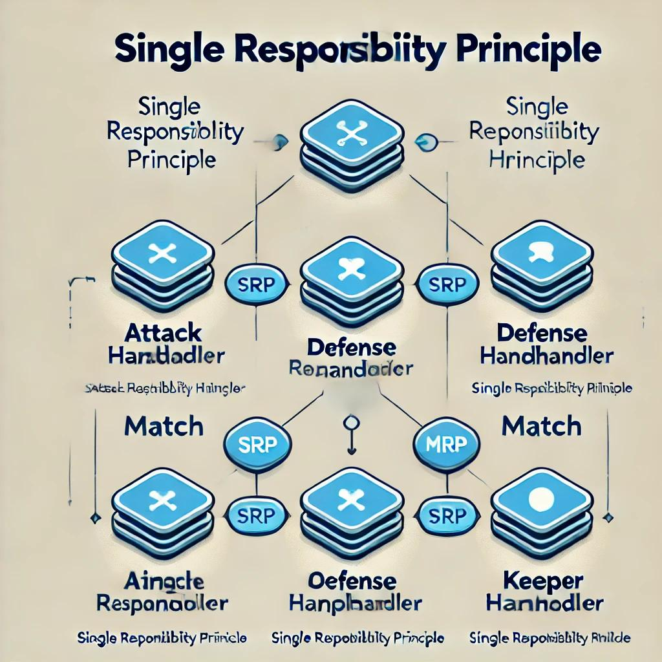
Example That Follows SRP
Separated Responsibilities:
- AttackHandler, DefenseHandler, KeeperHandler each in their own file.
Central Orchestration:
- Match class coordinates the handlers.
Benefits:
- Each class has one responsibility.
- Easier to maintain, test, and extend.

Slide 5
// In AttackHandler.php
class AttackHandler {
public function executeAttack() { return "Attack executed!"; }
}
// Similar for DefenseHandler and KeeperHandler.
// In Match.php
class Match {
public function __construct(AttackHandler $attack, DefenseHandler $defense, KeeperHandler $keeper) { ... }
public function simulate() {
return [
'attack' => $this->attack->executeAttack(),
'defense' => $this->defense->executeDefense(),
'keeper' => $this->keeper->executeSave(),
];
}
}

Slide 6
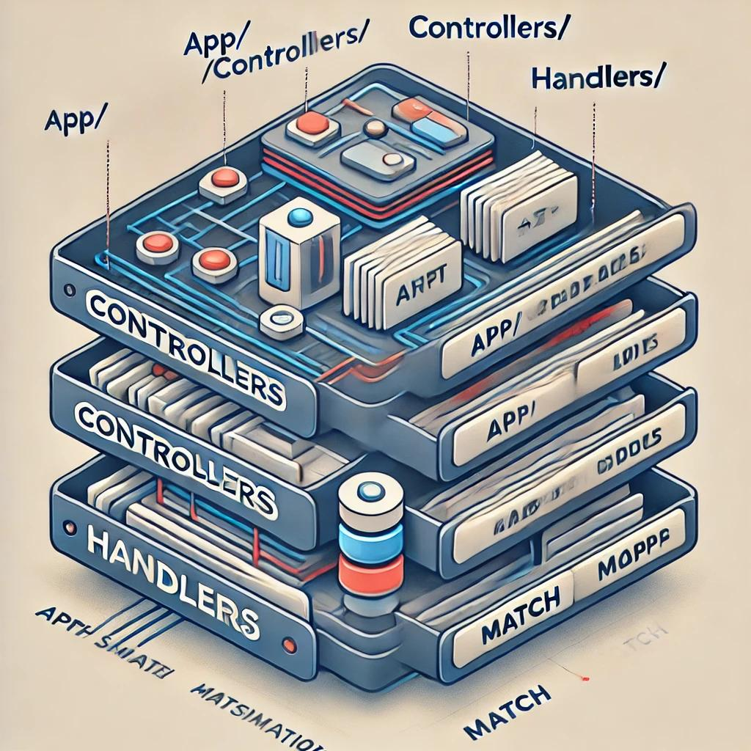
Recommended Folder Structure
app/
├── Http/
│ └── Controllers/
│ └── MatchController.php
├── MatchSimulation/
│ ├── Handlers/
│ │ ├── AttackHandler.php
│ │ ├── DefenseHandler.php
│ │ └── KeeperHandler.php
│ └── Match.php
Controllers: Handle HTTP requests and responses.
Handlers (Services): Encapsulate specific business logic.
Match Class: Orchestrates simulation using the handlers.

Slide 7
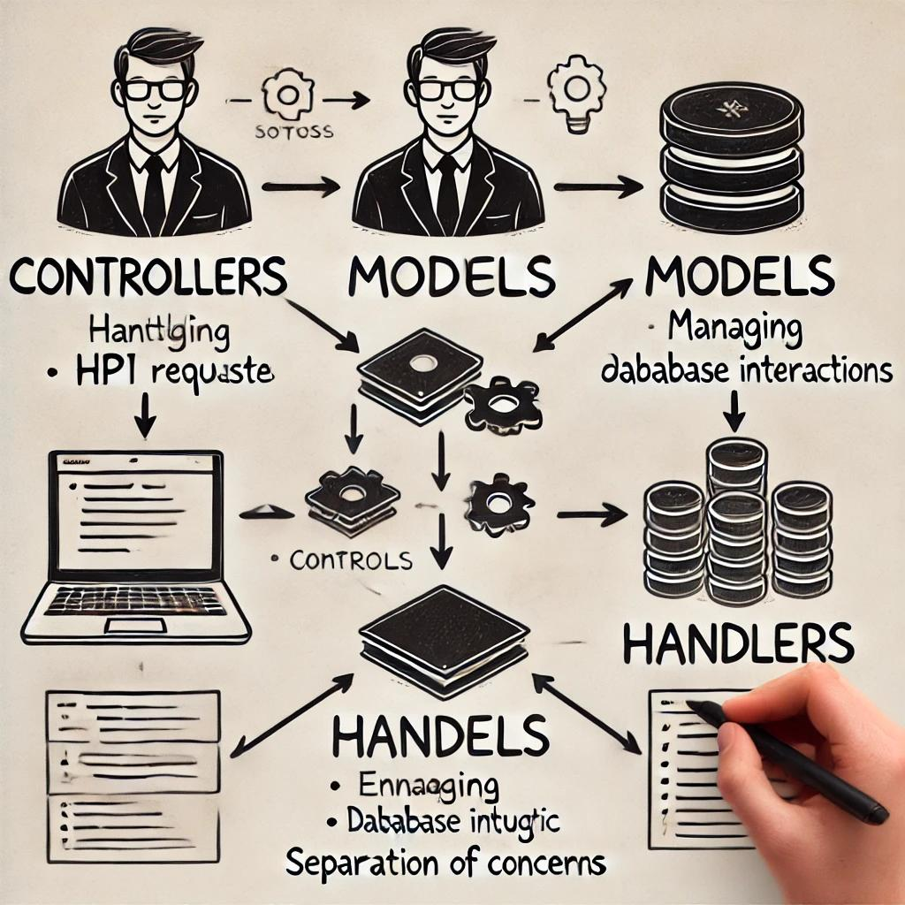
Understanding Controllers, Models & Handlers
Controllers: Entry points for HTTP requests. They should be lean.
Models: Represent data and interact with the database.
Handlers (or Service Classes):
- Purpose: Encapsulate business logic (e.g., attack, defense, keeper logic).
- Benefits:
- Promotes Separation of Concerns
- Enhances reusability and testability
- Keeps controllers and models focused on their roles

Slide 8
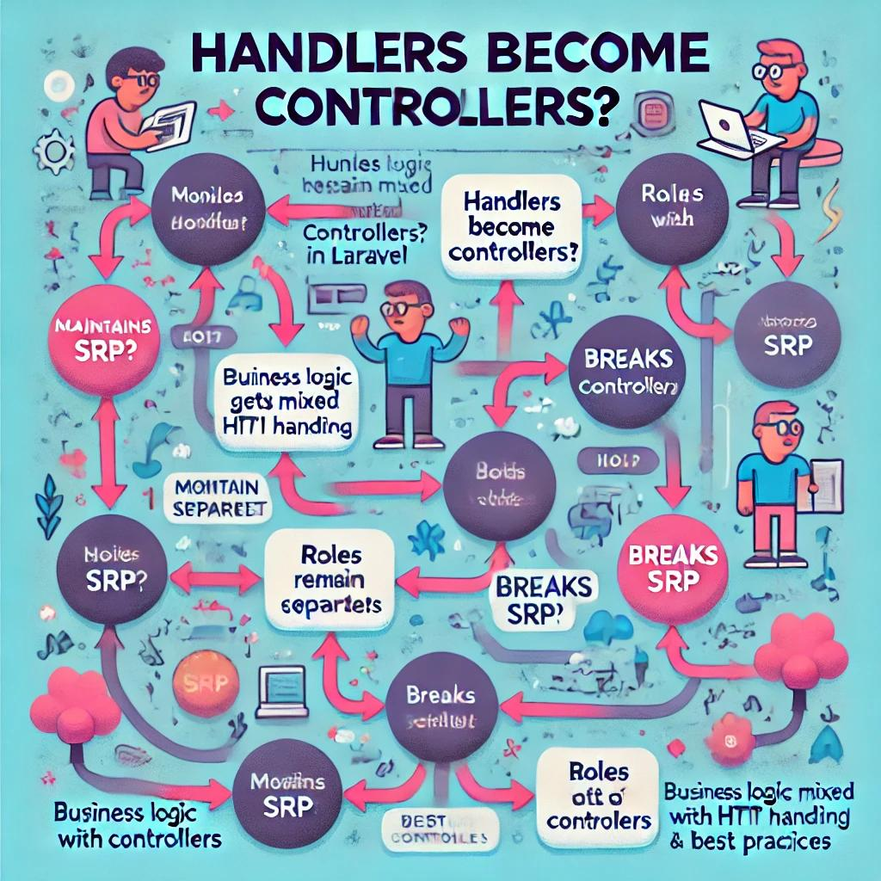
What If Handlers Become Controllers?
Scenario: Renaming or merging handlers as controllers.
Implications:
- SRP Compliance:
- If each controller still does one thing, SRP may not be violated.
- Best Practices:
- Mixing business logic in controllers couples HTTP handling with core logic.
- Leads to bloated controllers over time.
Conclusion:
- Keeping business logic in dedicated handler classes is the cleaner, more maintainable approach.

Slide 9
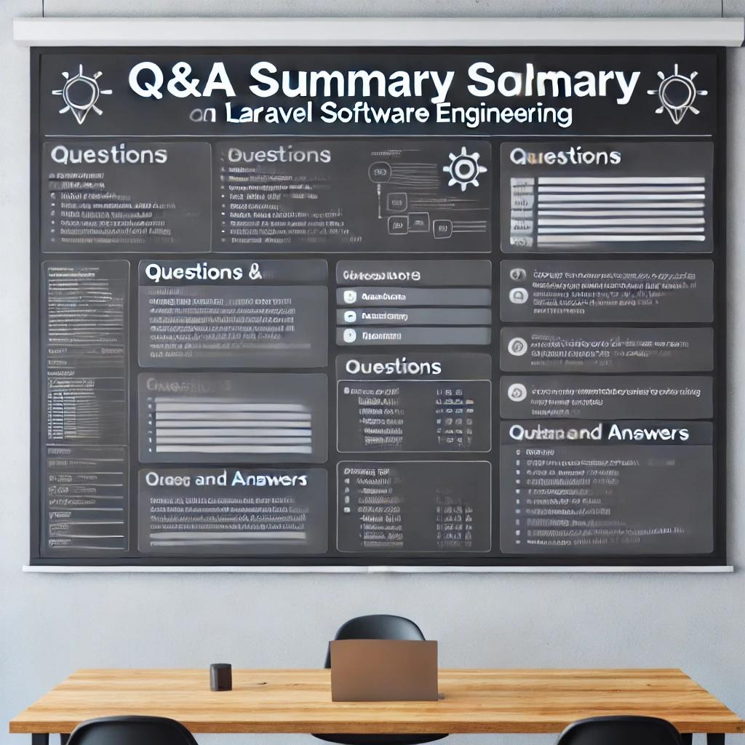
Q&A Summary
Q1: Why are handlers not controllers?
- Handlers encapsulate business logic and are independent of HTTP concerns, keeping controllers lean and focused on request/response.
Q2: What exactly are handlers?
- They are service classes that perform specific business tasks (e.g., executing an attack in a match simulation).
Q3: If I rename handlers as controllers, does that validate SRP?
- Renaming alone doesn’t break SRP if responsibilities remain isolated.
- However, merging business logic with HTTP handling is not best practice, as it can lead to bloated controllers and mixed concerns.

Slide 10
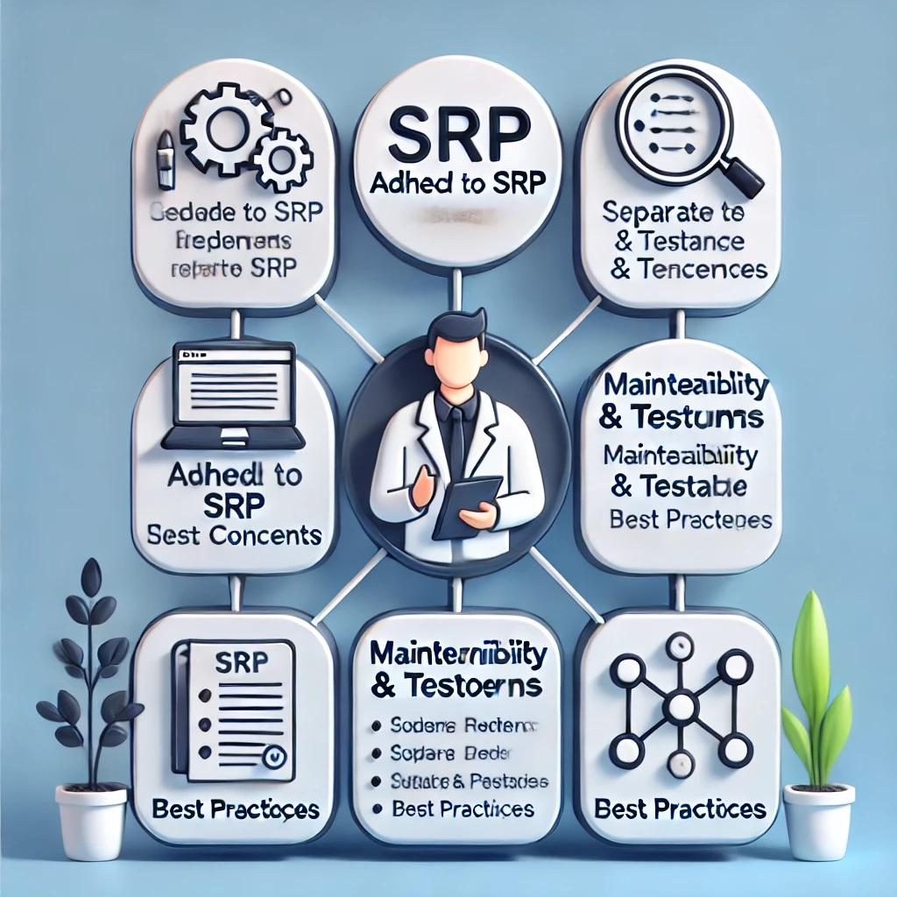
Takeaways
Adhere to SRP: Each class should have a single responsibility.
Separate Concerns: Use controllers for HTTP handling, models for data, and handlers for business logic.
Maintainability & Testability: Cleaner separation leads to code that is easier to test, extend, and maintain.
Best Practices: Keeping dedicated service classes (handlers) preserves the architectural integrity of your application.

